Slide 1
Content Moderation for text and image using TensorFlow.
PRESENTED BY: Sree Suvetha G
REG NO: 813821104097
DEPT: Computer Science and Engineering
COLLEGE: Saranathan College of Engineering
NM ID: sreesuvethag@gmail.com
(au813821104097)
3/21/2024 Annual Review

Slide 2
PROJECT TITLE
Content Moderation for text and image using TensorFlow.
3/21/2024 Annual Review

Slide 3


AGENDA
vPROBLEM STATEMENT
vPROJECT OVERVIEW
vWHO ARE THE END USERS?
vYOUR SOLUTION AND ITS VALUE PROPOSITION
vTHE WOW IN YOUR SOLUTION
vMODELLING
vRESULTS
3/21/2024 Annual Review

Slide 4

PROBLEM STATEMENT
To develop a deep learning model leveraging TensorFlow's capabilities to accurately evaluate both text and image content. This model will assess the appropriateness of provided text and images, classifying them as suitable or unsuitable for posting, and provide recommendations based on TensorFlow's machine learning capabilities. The goal is to create a versatile deep learning solution capable of analyzing both text and images and determining their suitability for publication.
3/21/2024 Annual Review

Slide 5

PROJECT OVERVIEW
The project aims to develop a versatile computer program utilizing TensorFlow to automate the content moderation process for both text and image content. We aim to enhance efficiency in content moderation while upholding platform integrity and ensuring user safety. This model can be applied to social media platforms for automatic detection and removal of offensive content, as well as in e-commerce sites to ensure a positive shopping experience by filtering out inappropriate images and text.
3/21/2024 Annual Review

Slide 6

WHO ARE THE END USERS?
Social media users
Content creators
Content moderators
Parents and guardians
News and media outlets
Cyber security experts
3/21/2024 Annual Review

Slide 7
YOUR SOLUTION AND ITS VALUE PROPOSITION
Solution:
The solution for content moderation using deep learning involves training separate models for text and image analysis. These models classify content into appropriate or inappropriate categories, reducing the burden on human moderators and preventing the spread of harmful content online.
Value Proposition:
Efficiency boost
Improved user experience
Flexible and Scalable
Enhance online safety
Regulatory compliance
3/21/2024 Annual Review

Slide 8
THE WOW IN YOUR SOLUTION
Advanced Architectures: Utilizing cutting-edge neural networks for precise identification of offensive language in text and inappropriate content in images.
NLP and CV Fusion: Integrating natural language processing and computer vision techniques for comprehensive moderation of textual and visual content.
Transfer Learning Adaptability: Efficiently adapting pre-trained models for rapid deployment and improved accuracy in detecting offensive content across various media formats.
Augmented Data Handling: Enhancing data augmentation techniques to diversify training data for robust recognition of offensive language and imagery.
Interpretability and Trust: Promoting model transparency to instill confidence in the moderation process, ensuring trustworthiness for both text and image content.
3/21/2024 Annual Review
8

Slide 9
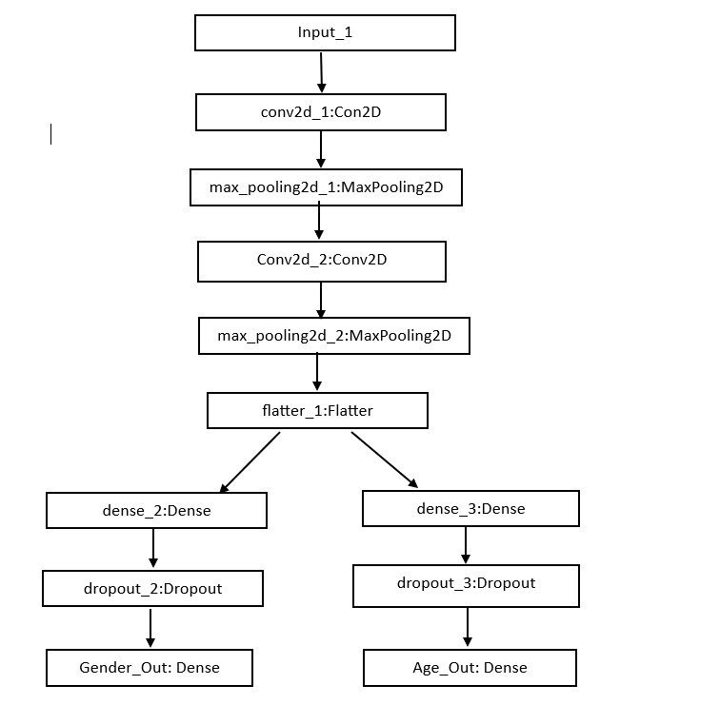
MODELLING
3/21/2024 Annual Review
9

Slide 10
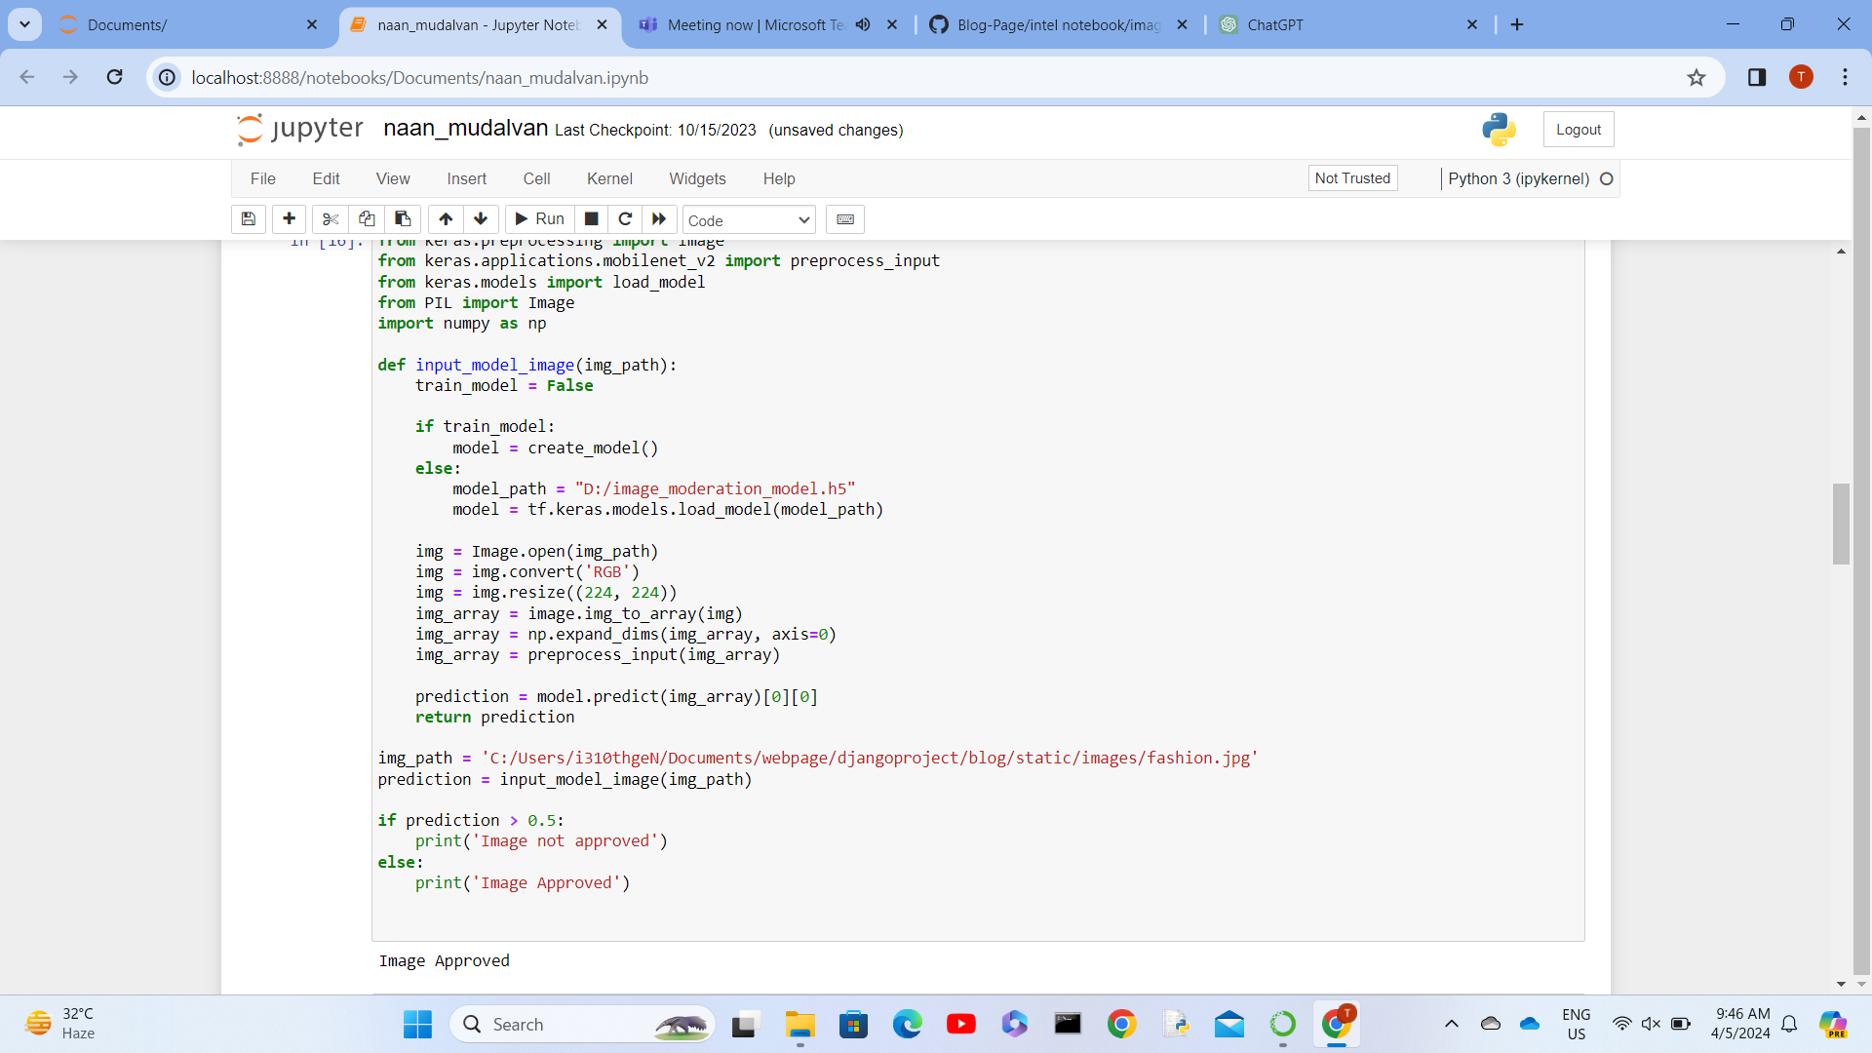
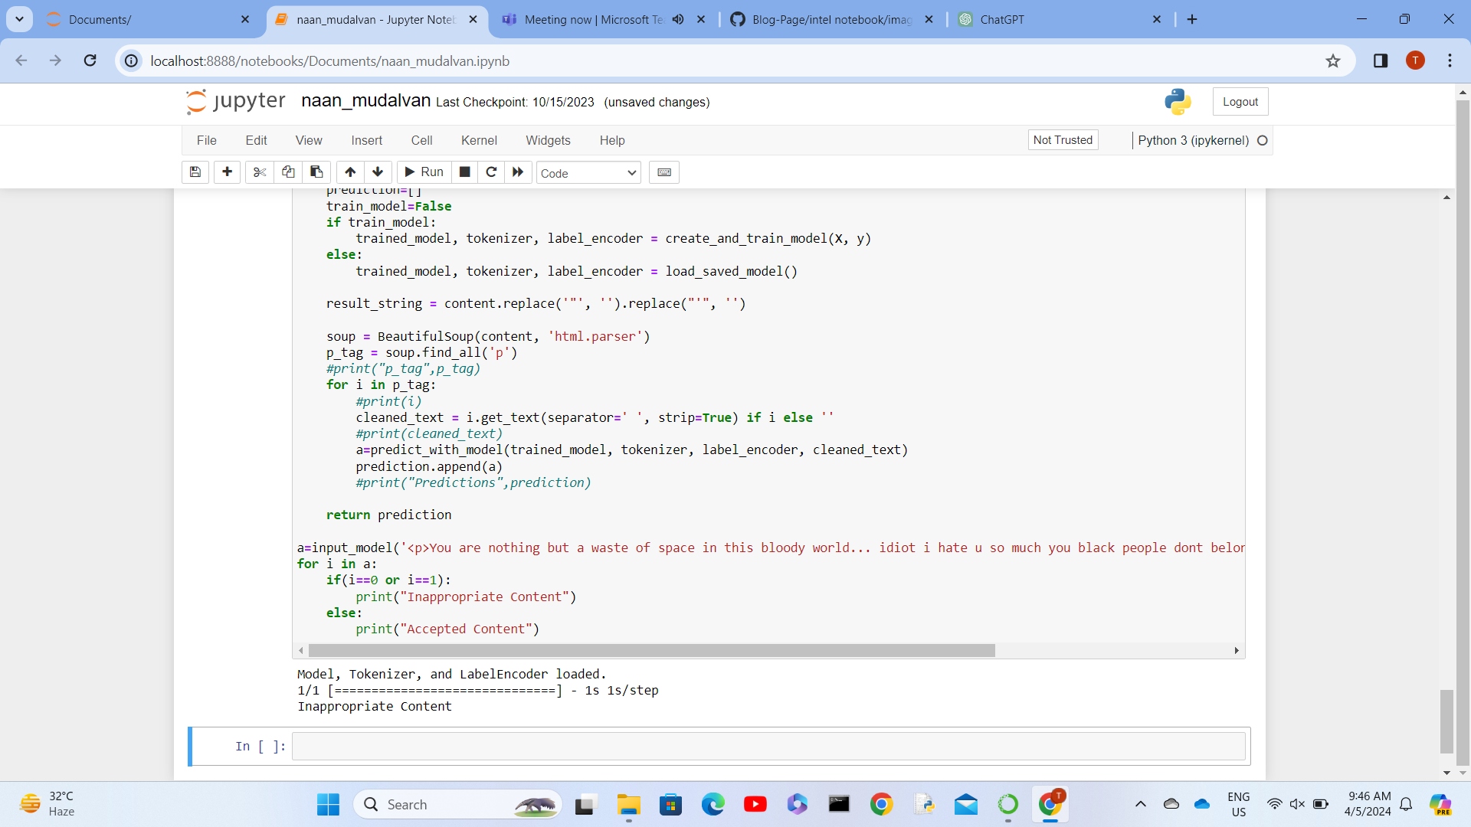
RESULTS
This TensorFlow-driven project effectively categorizes user-generated content, ensuring compliance with regulatory standards for both text and image moderation. Through continuous refinement, the model aims to cultivate a positive and inclusive online experience for all users.
https://github.com/Sree-Suvetha/TNSDC-GENERATIVE-AI
3/21/2024 Annual Review
10

